Slide 1

Fate AI: AI-Powered Divination on Sui
Explore Fate AI, a new suite of AI-driven divination tools on the Sui blockchain. Discover insights and predictions through various AI characters. Engage with a unique blend of technology and fortune-telling.

Slide 2

Diverse AI Characters for Predictions
1
Multiple AI Roles
2
Intelligent Answers
3
Varied Divination
Interact with a variety of AI characters. Each AI offers unique divination methods and insights.
Receive smart, AI-generated responses to your questions. Uncover personalized predictions.
Experience different AI divination styles. Each offers a fresh perspective.

Slide 3
Swap Fate Tokens on Sui
Token Swap
Stablecoin Support
Seamless Transactions
Easily swap Fate tokens.
Supports stablecoins on the Sui network.
Enjoy quick and secure token swaps.

Slide 4
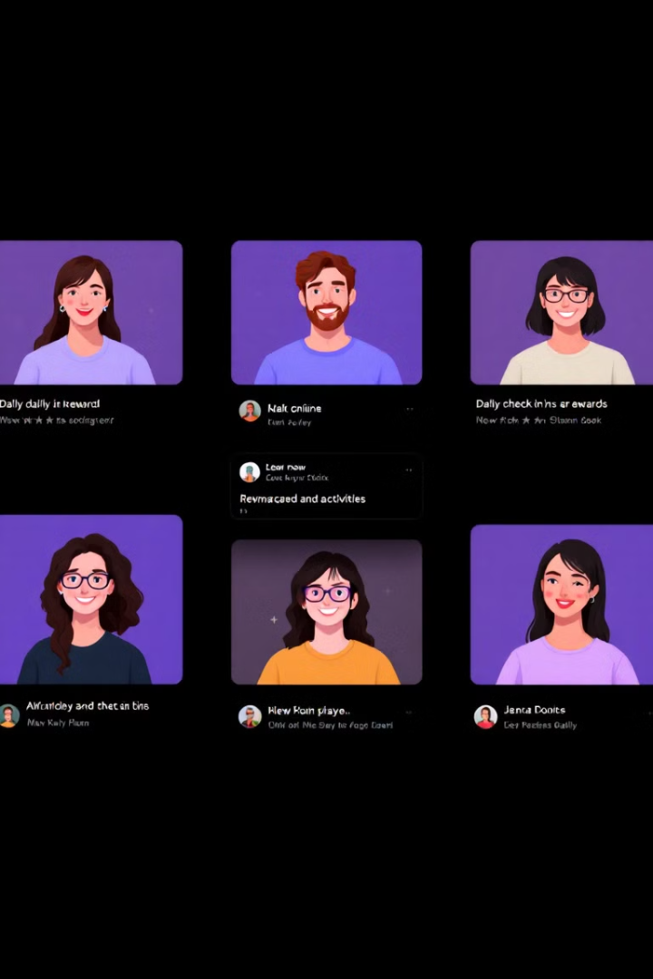



Daily Check-In for Community Rewards
Daily Sign-In
Community Engagement
Incentive System
Check in daily to earn rewards.
Motivate active participation.
Boost community activity. Earn valuable prizes.

Slide 5
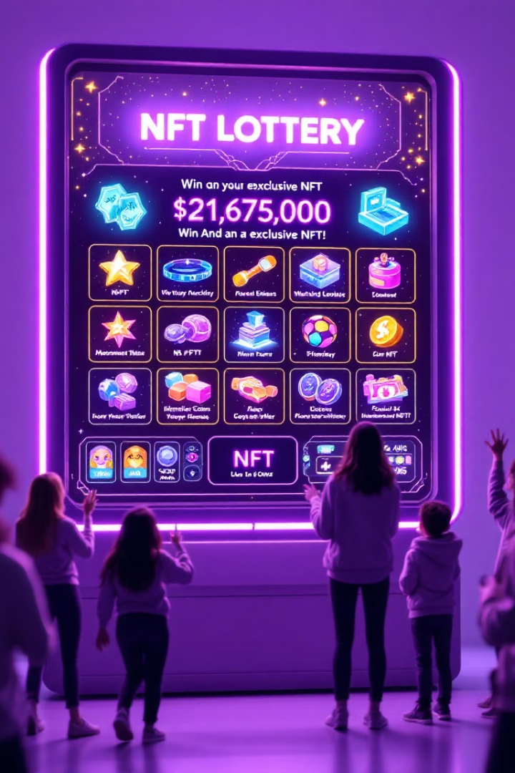



NFT Lottery System
NFT Draws
Participate in NFT lottery draws.
Luck-Based Rewards
Combine luck and NFT rewards.
Exclusive Prizes
Win rare and valuable NFTs.

Slide 6

Thank You
Thank you for your attention. Stay tuned for more updates. Explore Fate AI on the Sui blockchain.

